Slide 1
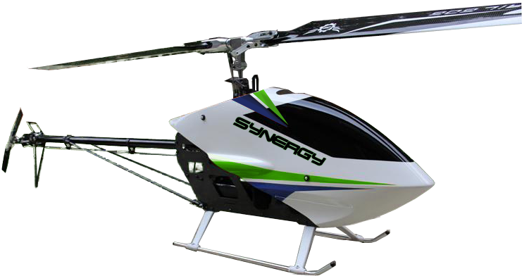
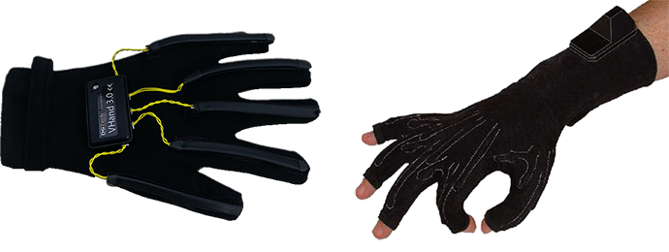
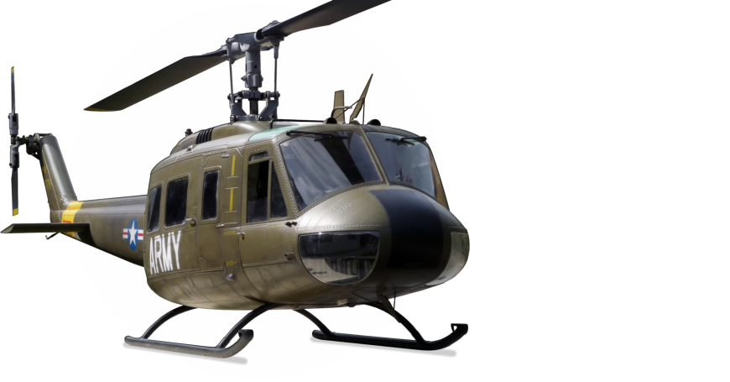
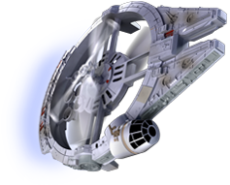
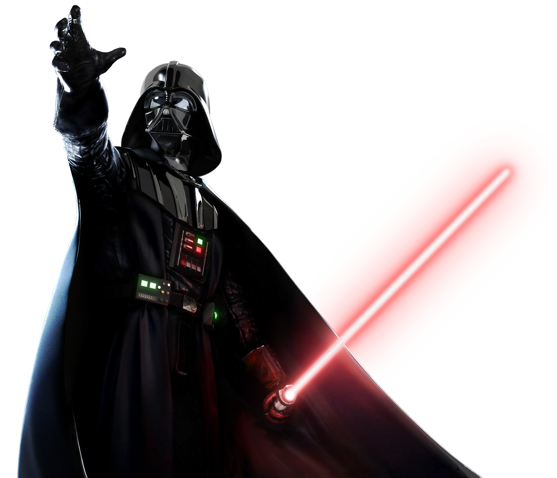
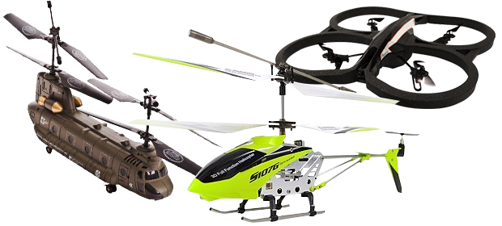
Motion Control RC Copter
By:Kenny Chiu

Slide 2
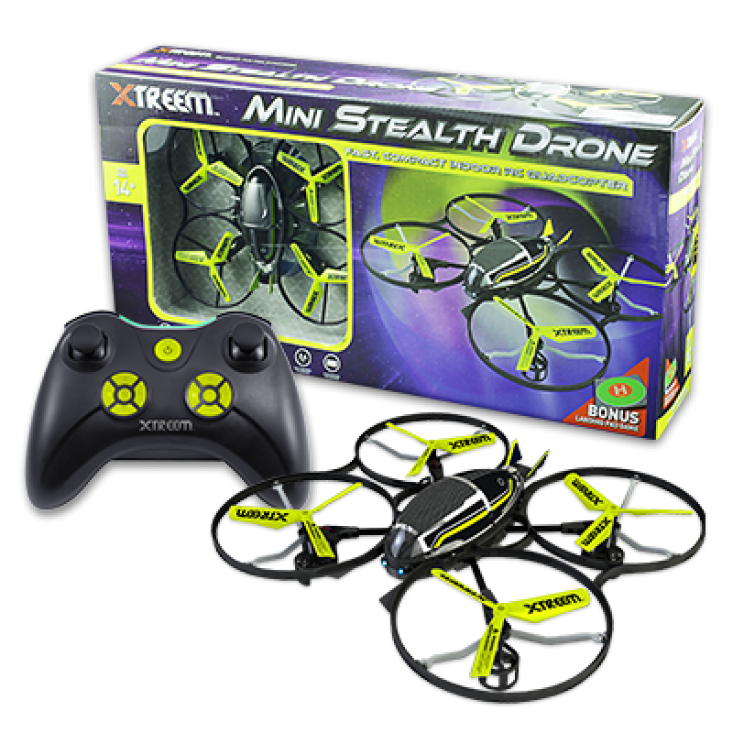
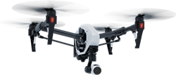
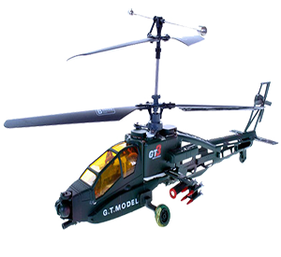
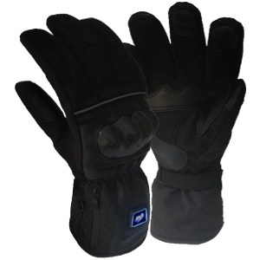
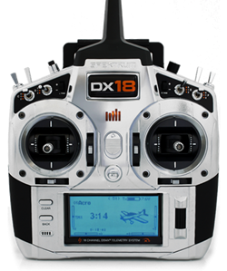
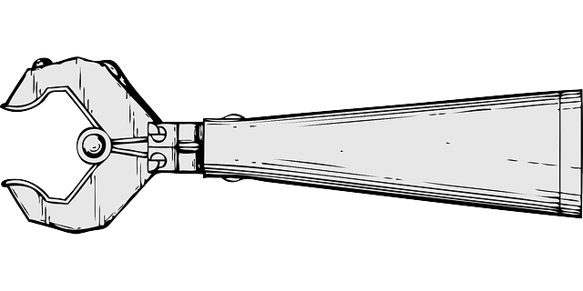
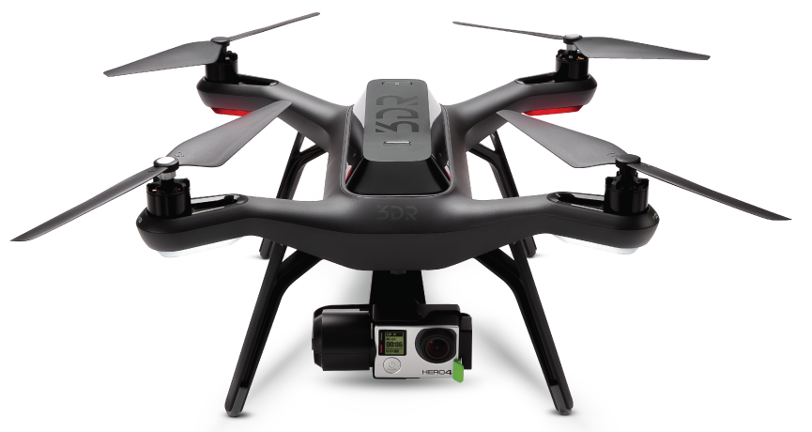
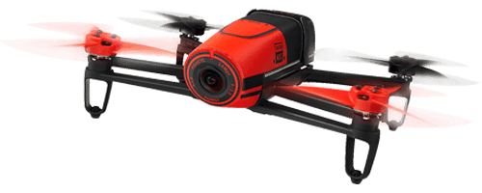
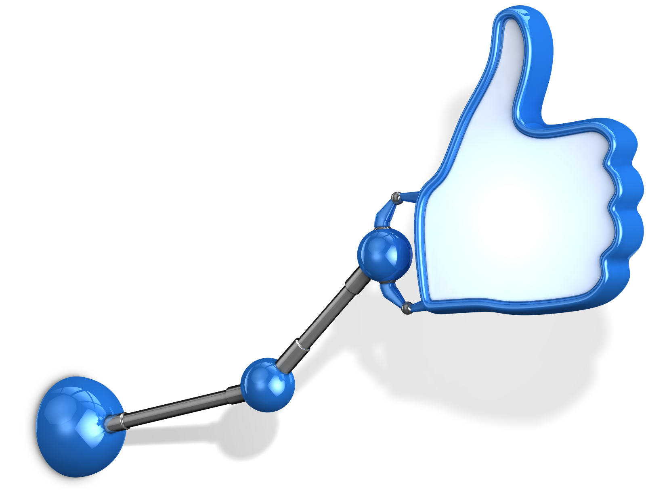
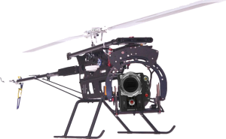
What is the idea?:
The Motion Control RC Copter is a toy.
Functions like any regular RC helicopter
Except with motion control built onto a glove
Additional parts can be added such as camera that feed into a set of glasses or a set of mechanical claw controlled by another motion controller, etc.

Slide 3
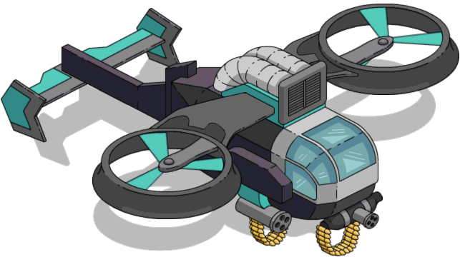
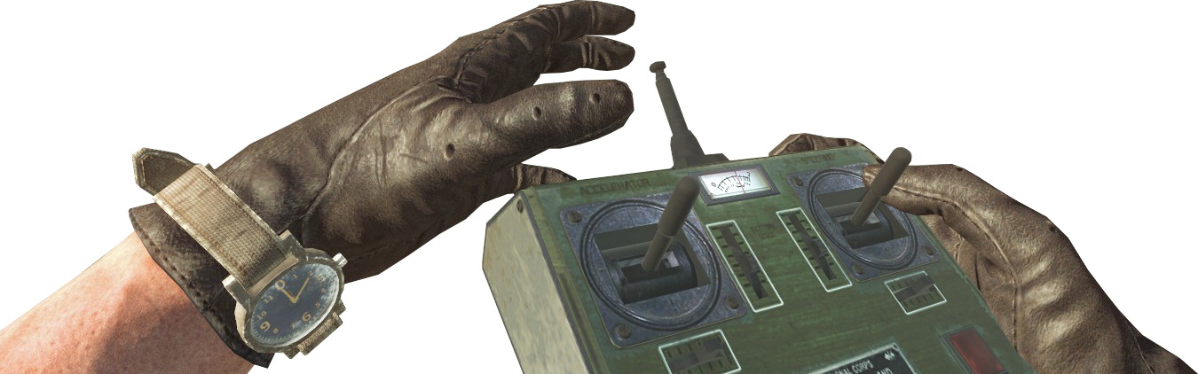
Who is this idea for?:
As any regular toy, its something that could be used by anyone of age four and above.
The copter isn’t any demographically specific as it is only a toy

Slide 4

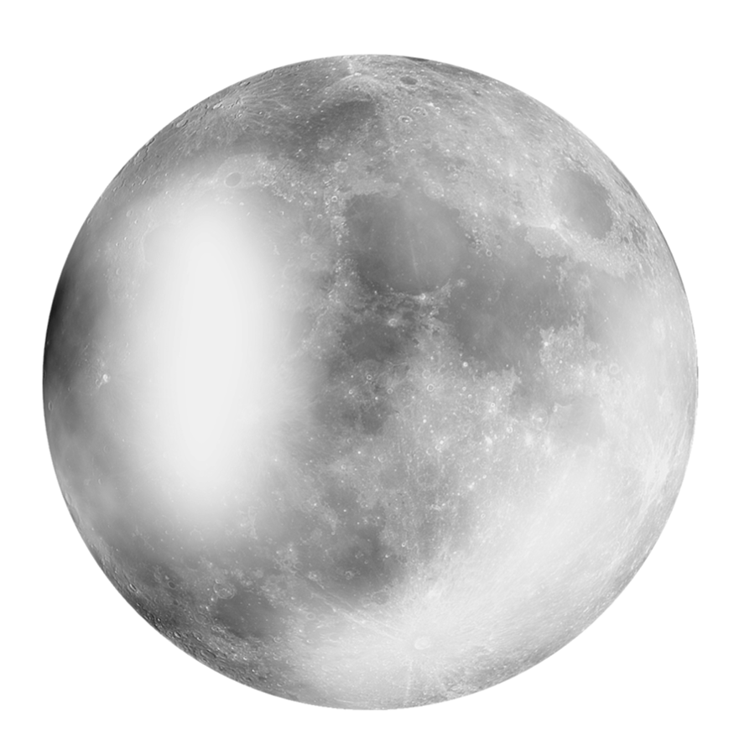
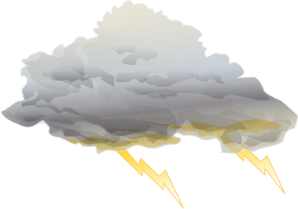
When should it be used?:
Like any typical RC Copter, it can be used whenever
During the day or night(Day is highly recommended to prevent losing the copter itself)
Can be used during good weather. Usage during rain or snow is highly not recommended until further testing.

Slide 5


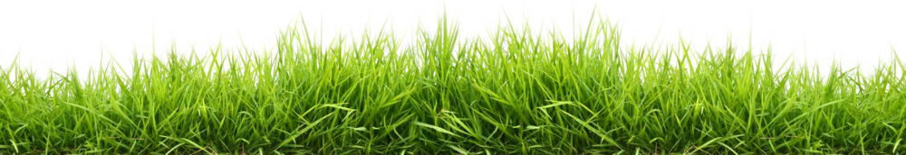
Where could it be used?:
Like any toy, it could be used both indoor and outdoor. It is best used outdoor but the copter itself should be small enough for indoor usage.

Slide 6

How does it work:
The different motions and movement between hands and fingers will send different signal to the copter.
Instead of a remote, the movement of your hand will be the remote.
Specific: The specific movement for the control should be basic. General direction such as up, down, left and right should follow the finger’s movement such as pointing to the left causes the copter to go left. The copter is designed to move left while its back is facing the user. Left and right will change depending on which side face the user. The helicopter could be moved back by moving the whole hand back and vice versa. It turns around towards the right by moving the whole hand upward and opposite with the whole hand downward. When the hands are closing, the copter will move backward towards the user and when the hand opens it will cause the copter to fly away from the user. Due to this, there is a limited distance which the helicopter will fly away from the user.

Slide 7
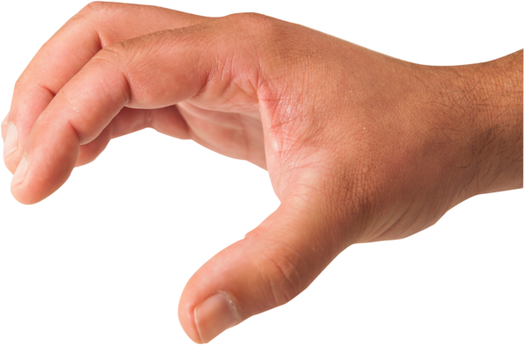

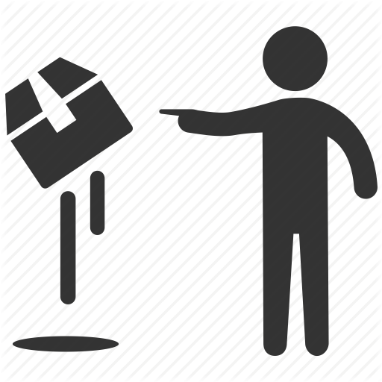
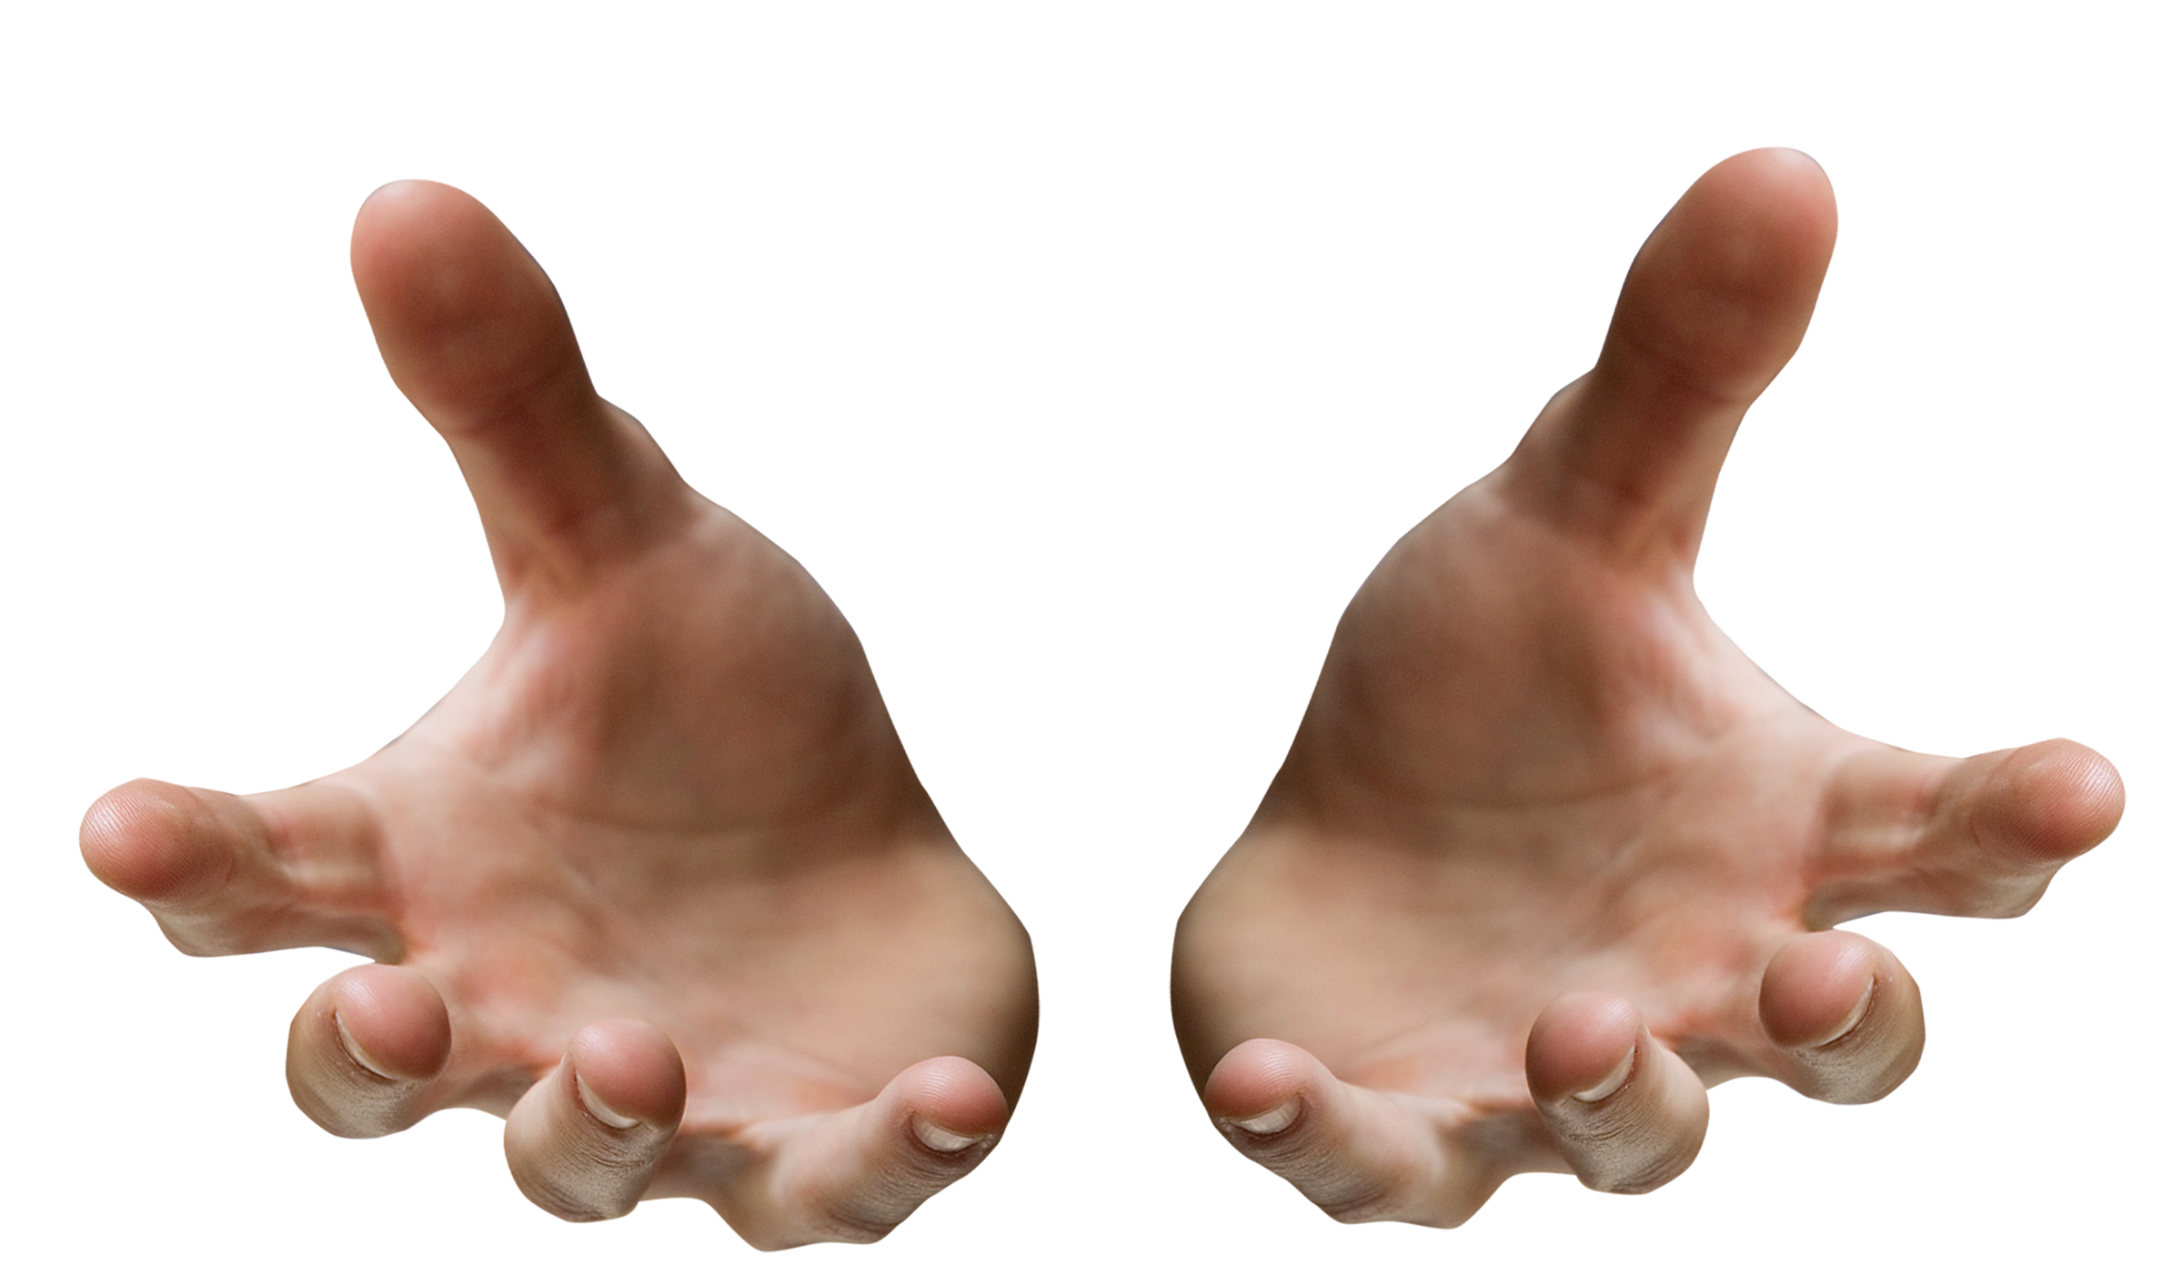
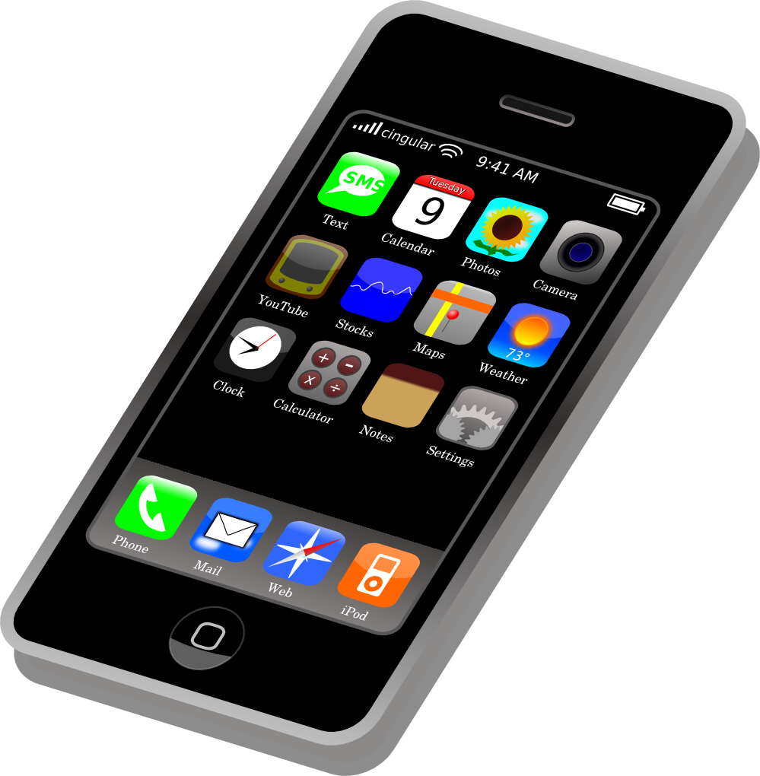
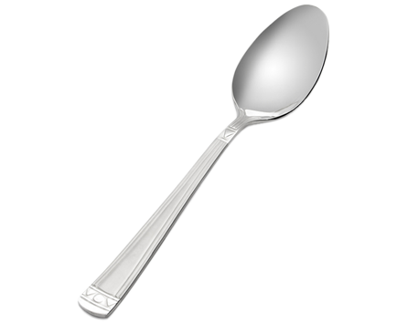
Why does this idea exist?:
The main purpose is simply for entertainment.
The other purpose being the helicopter is an experiment meant to test technology regarding controlling objects without physical interference from a user.

